Slide 1
Lab 4 Filing in C
By Sumaiyah Zahid

Slide 2
File Operations
Creating a new file
Opening an existing file
Closing a file
Reading from and writing information to a file

Slide 3
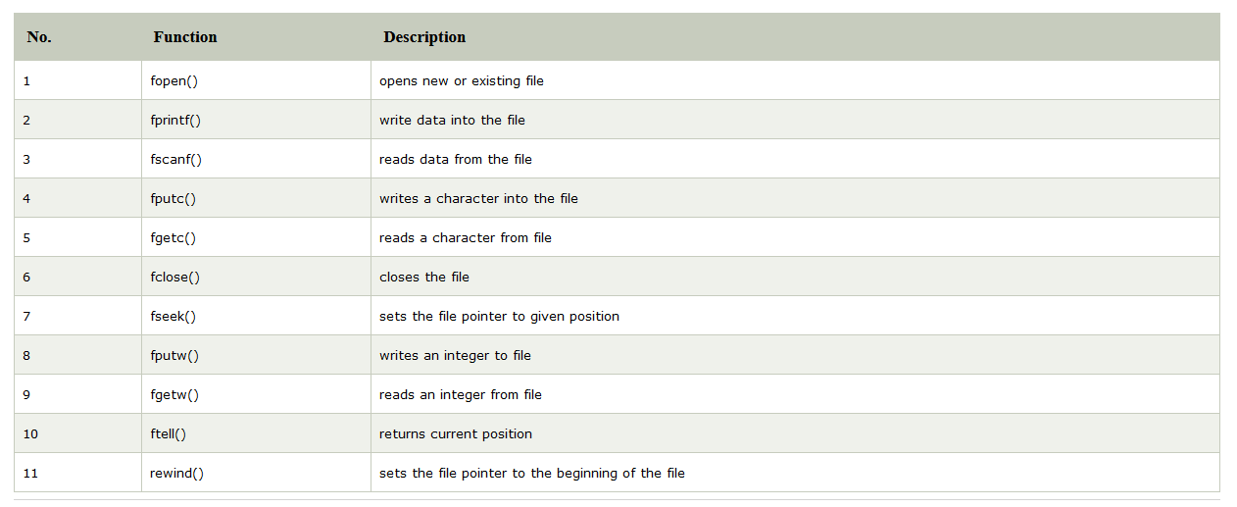
Function for file handling

Slide 4

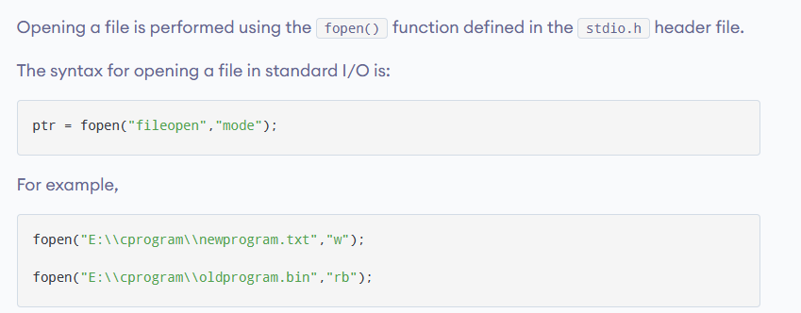

File opening and closing

Slide 5
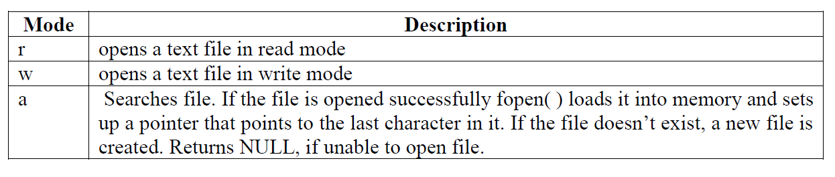
Opening Modes
r+ for both reading and writing
w+ for both reading and writing
a+ for both reading and appending

Slide 6
Writing to a text file
#include <stdio.h>
#include <stdlib.h>
int main()
{ int num;
FILE *fptr;
fptr = fopen("program.txt","w");
if(fptr == NULL)
{
printf("Error!");
exit(1); }
printf("Enter num: ");
scanf("%d",&num);
fprintf(fptr,"%d",num);
fclose(fptr);
return 0;
}

Slide 7
Reading from a text file
#include <stdio.h>
#include <stdlib.h>
int main()
{
int num;
FILE *fptr;
if ((fptr = fopen("program.txt","r")) == NULL){
printf("Error! opening file");
exit(1);
}
fscanf(fptr,"%d", &num);
printf("Value of n=%d", num);
fclose(fptr);
return 0;
}

Slide 8
Putc, getc, gets, puts
There is always an ocean of knowledge which depends on your motivation how deep you want to dive!
https://www.javatpoint.com/fputc-fgetc-in-c
https://www.javatpoint.com/fputs-fgets-in-c

Slide 9
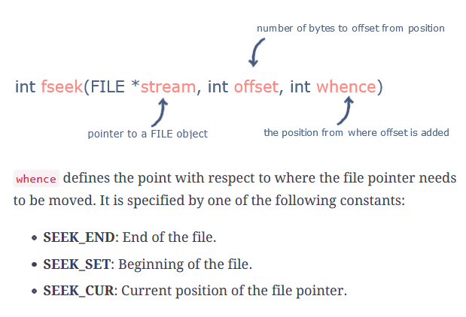
Using fseek()
#include <stdio.h>
void main(){
FILE *fp;
fp = fopen("program.txt","w+");
fprintf(fp,"This is section c of programming!");
fseek( fp, 7, SEEK_SET );
fprintf(fp,"best section");
fclose(fp); }

Slide 10
Fseek
There is always an ocean of knowledge which depends on your motivation how deep you want to dive!
https://www.educative.io/edpresso/what-is-fseek-in-c

Slide 11
Lab activity
Write a program to read a file and display contents with its line numbers.
Make a factorial program which takes input from a file input.txt and saves the output in another file result.txt.
Make a program which reads all the text from a file but saves only count of vowels to another file.

Slide 12


